Slide 1
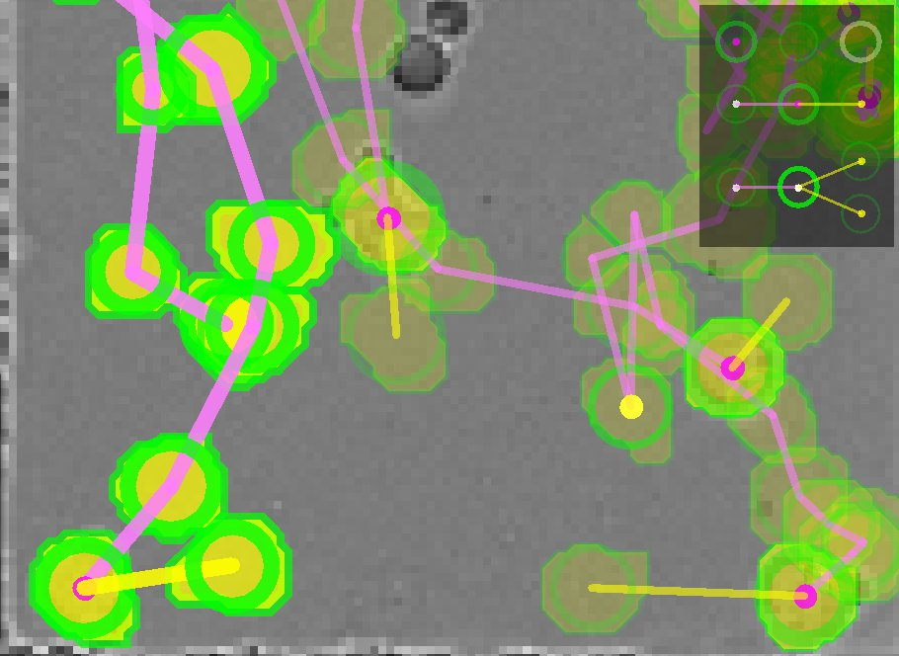
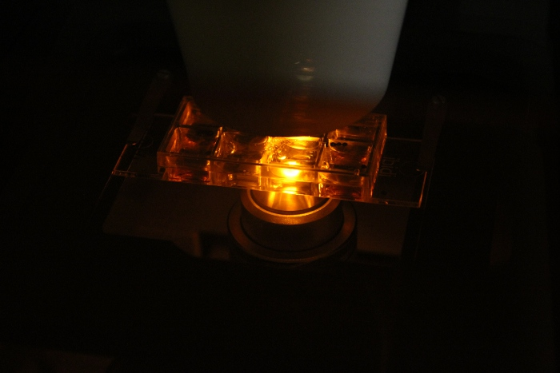
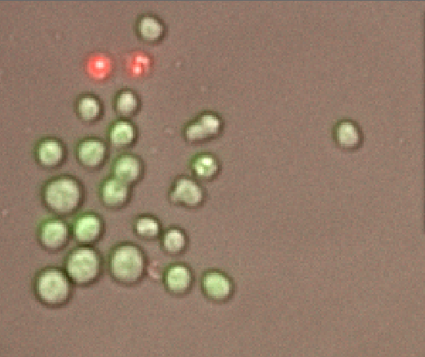
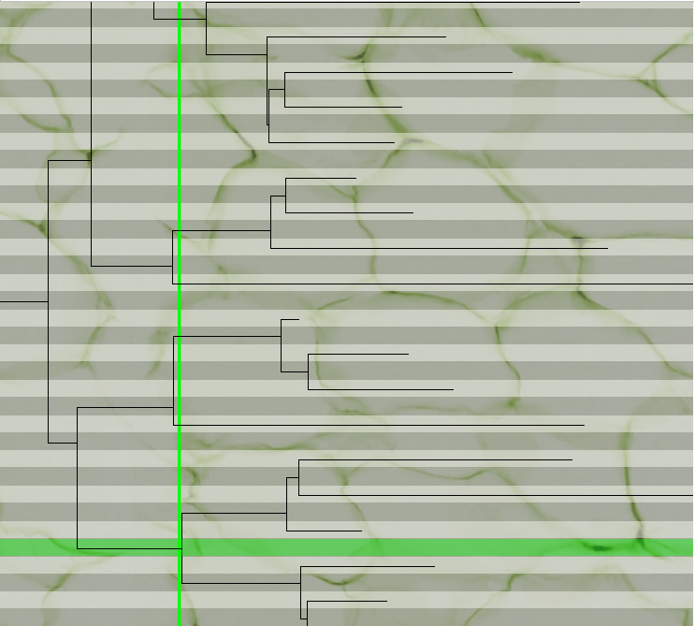
Automated Microscopic Image Analysis
We are developing software tools for tracking mobile cells in time-lapse microscopy images. These tools have the potential to save Immunology researchers thousands of hours in every experiment,
greatly increasing the ambition and quantity of experiments conducted.
[insert hero image]
Problem/Opportunity
Solution or Approach
Immunology researchers want to reconstruct the lineages of B-Lymphocytes, but this requires tracking every individual cell in populations of hundreds, over a period of several days
The lineage of B-Lymphocytes is critical in determining their fates and behaviour
This is currently a hugely time-consuming, expert manual task
These efficiency constraints are holding back further research
NICTA has partnered with the Immunology Lab at Walter & Eliza Hall Institute for medical research (WEHI)
We are combining NICTA’s expertise in object tracking & image processing, with WEHI’s experience of immunology modelling
Jointly developed wet-lab imaging protocols and data-processing algorithms, for optimum results
A specific and novel approach to Immunology, driven by WEHI’s groundbreaking research
Impact
NICTA’s role and next steps
[optional image or graph]
TrackAssist software released to WEHI collaborators, Feb. 2012
Other Immunology groups will adopt TrackAssist for B-Lymphocyte tracking during 2012
Now extending to T-Lymphocyte in collaboration with HIV research group at the Burnet Institute, Melbourne
Activation-Induced B Cell Fates are selected by Intracellular Stochastic Competition. Science, Jan. 2012
Automated and Semi-automated Cell Tracking: Addressing Portability Challenges. Journal of Microscopy, 2011
TrackAssist – a framework for live cell tracking, annotation & analysis. Hunter Valley Meeting of Cellular Biology, Mar. 2012
NICTA aims to become an expert centre in bio-image processing, particularly time-lapse microscopy
We are seeking to engage with other Immunology groups to promote WEHI’s vision of Immunology and NICTA’s solution for this approach
NICTA expects that the techniques developed here could be applied beyond Immunology: For example, tracking and monitoring the behaviour and lineages of stem cells.
Technical Contact:
Rajib.Chakravorty@nicta.com.au
Business Contact:
Jia-Yee.Lee@nicta.com.au
This project is part of NICTA’s Health Business Team.
Research Excellence in ICT
Wealth Creation for Australia

